Slide 1
TAS152
LECTURE 5
TOPIC 1
CYBER SOCIETY: CORE VALUES AND VIRTUES
1.6 CYBER ETHICS BY NORMS, LAWS AND RELATIONS

Slide 2
RECAP
Cyber-citizenship.
Eleven principles to guide ethics and values in cyberspace:
Dignity
Freedom
Honesty
Justice
Peace
Privacy
Participation
Integrity
Inclusiveness
Equity
Security

Slide 3
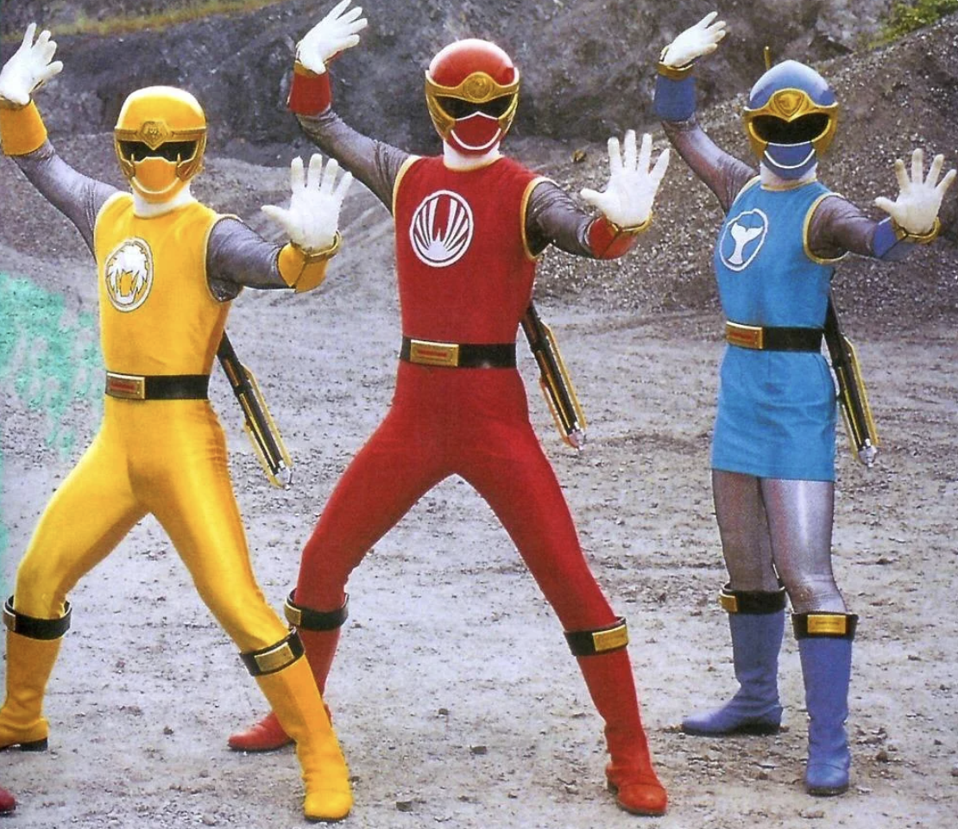
CYBER ETHICS BY NORMS, LAWS AND RELATIONS
How is self-regulation and responsibility created in communities?
Rules of Ethics
Rules of Law
Rules of Relations

Slide 4
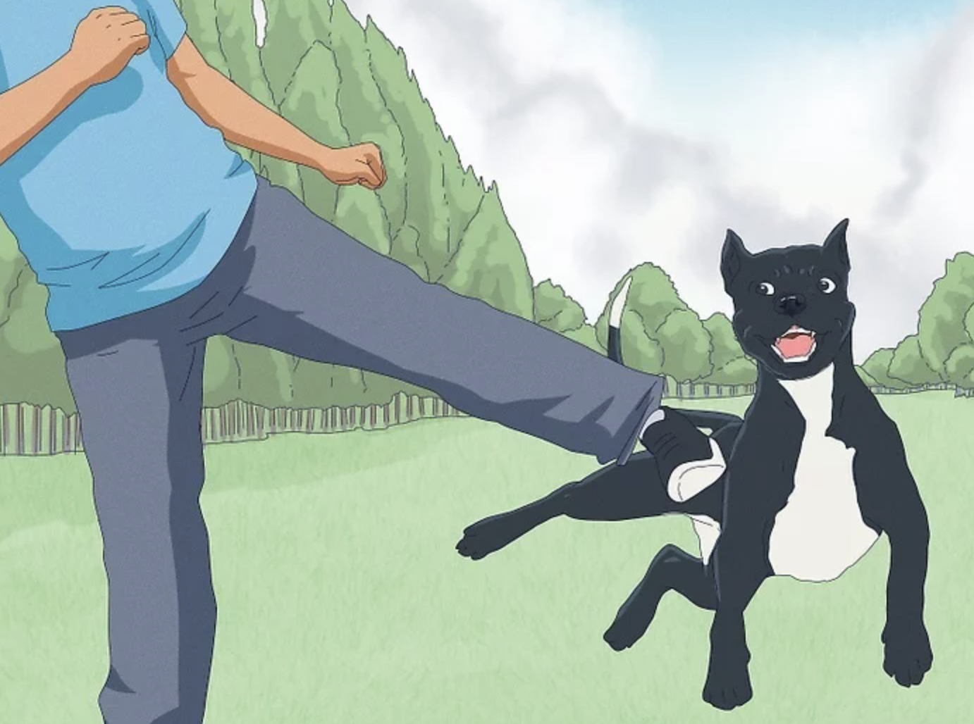
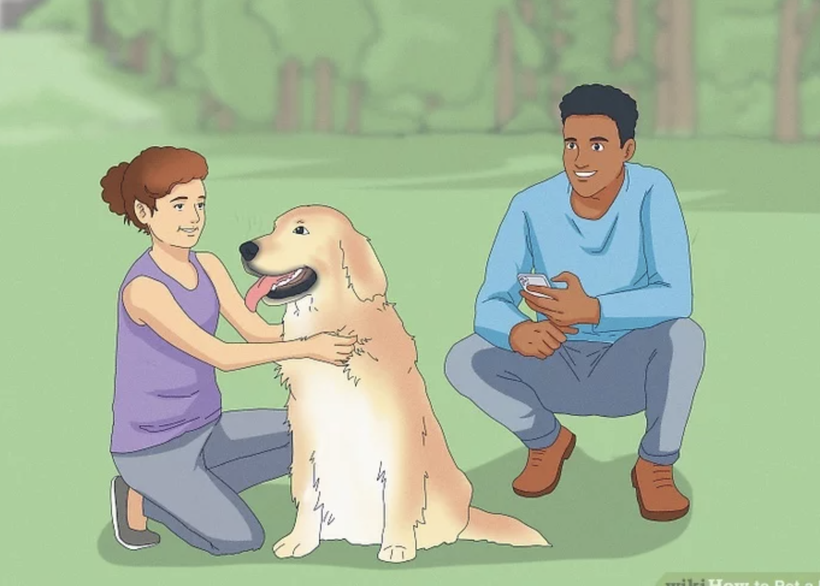
RULES OF ETHICS
Shared community values i.e. "just do the right thing"
Don't litter.
If you find a bag full of money on the street, don't just keep it, take it to a police station.
Do not harm animals.

Slide 5
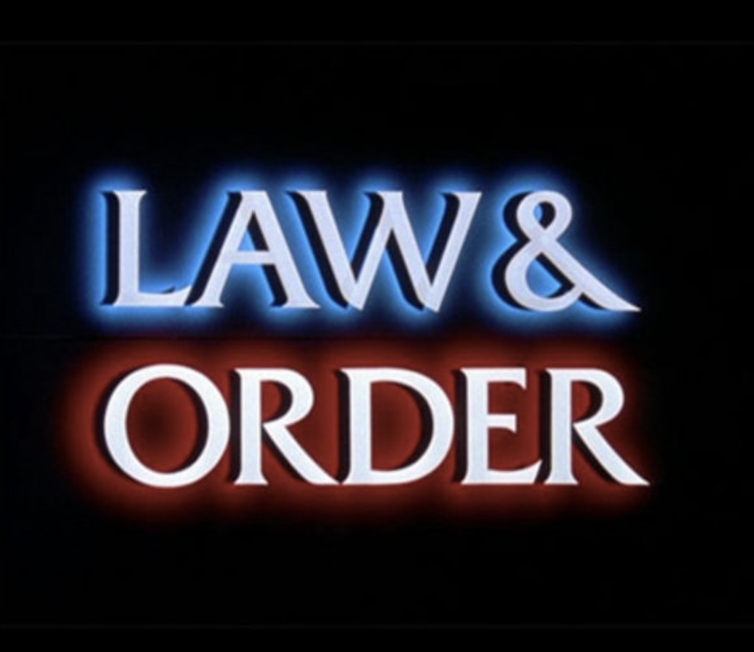
RULES OF LAW
Formally codified and focuses on trust, reliability, control of power, maintains the status quo
Do not exceed the speed limit
Do not commit tax fraud
Do not distribute illegal drugs
Do not give government contracts to family members in exchange for a kickback.

Slide 6
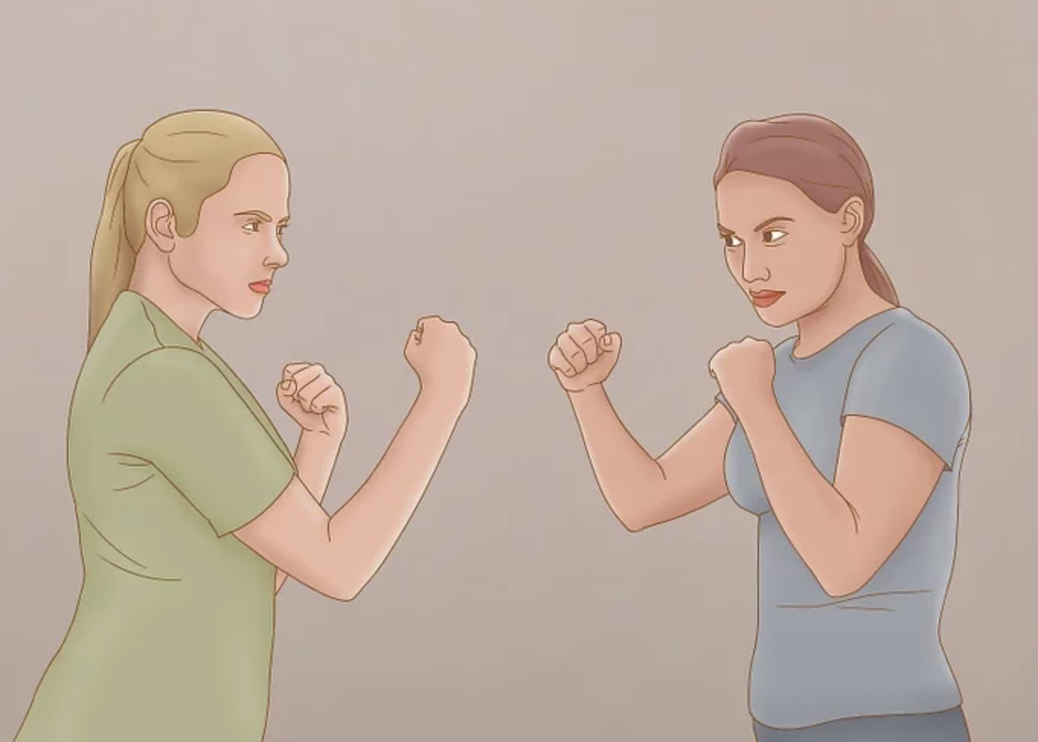

RULES OF RELATIONS
Intended to support humane relationships between individuals and communities.
Do not discriminate against others based on their race, religion, gender or physical abilities.
Do not physically harm other human beings.
If you are aware of abuse/discrimination, even if you are not perpetrating it, you should try and stop it.
If someone asks you for help and you are able to help, you should do so.

Slide 7
WHAT HAPPENS WHEN WE DON'T BALANCE THESE?
A society needs "Rules of Law" as it is not sufficient to only rely on "Rules of Ethics" and "Rules of Relations".
A society that only uses "Rules of Law" but has no "Rules of Ethics" will mean that people doing the right thing is only enforced by the government, not by regular people.
A society that only uses "Rules of Law" and "Rules of Ethics" might lead to a situation where people behave, but they don't actually respect one another ("Rules of Relations" is missing).

Slide 8
STUCKELBERGER'S HIERARCHY
Discretionary
decisions
Less binding
Contextual values (maxims)
More concrete/specific
Fundamental values (criteria)
Fundamental premise

Slide 9
STUCKELBERGER'S HIERARCHY
Don't share
the database
admin password
Less binding
National laws,
international standards.
More concrete/specific
The eleven principles for cyber ethics
Do not kill people, do not hurt animals etc.

Slide 10
SUSTAINABLE DEVELOPMENT GOALS
No poverty
Zero hunger
Good health and well-being
Quality education
Gender equality
Clean water and sanitation
Affordable and clean energy
Decent work and economic growth
Industry, innovation and infrastructure
Reduced inequalities
Sustainable cities and communities
Responsible consumption and production
Climate action
Life below water
Life on land
Peace, justice, and strong institutions
Partnerships for the goals

Slide 11
SUSTAINABLE DEVELOPMENT GOALS
OBJECTIVE | SGD(s)
1. A guarantee of basic human needs, by ending extreme poverty and achieving food security | 1, 2
2. Ensuring healthy lives and providing quality education | 3, 4
3. Equality of all human beings, including gender equality | 5
4. Ensuring access to clean water and sanitation, affordable energy and productive employment | 6, 7, 8
5. Infrastructure development and the reduction of income inequality, provision of safe housing and basic services | 9, 10
6. Provision of safe housing and basic services | 11
7. Responsible consumption and production | 12
8. Climate action, sustainable use of marine resources and sustainable management of ecosystems | 13, 14, 15
9. Promote peaceful and inclusive societies, provide access to justice for all, build global partnerships for sustainable development | 16, 17

Slide 12
ACTIVITY
How is South Africa tracking towards completing its SGDs?
https://dashboards.sdgindex.org/profiles

